Slide 1
Problem solving with graphing linear relationships
Graphical representations of linear equations

Slide 2
how to use Oak lessons

Slide 3
I can use my knowledge of graphing linear relationships to solve problems.

Slide 4
The rate of change is how one variable changes with respect to another. If the change is constant, there is a linear relationship between the variables.
The gradient is a measure of how steep a line is. It is calculated by finding the rate of change in the y-direction with respect to the positive x-direction.

Slide 5

Problem solving with graphing linear relationships
Problems involving linear graphs
Interpreting more complex linear graphs

Slide 6



Problems involving linear graphs
Some pupils are collecting sweets.
Aisha starts with 6 sweets and gains 1 more per day.
Jacob starts with 0 sweets but gains 2 per day.
Izzy starts with 14 sweets but eats 2 per day.
Who has the most sweets?
It depends on the number of days.

Slide 7
Problems involving linear graphs
Some pupils are collecting sweets.
Aisha starts with 6 sweets and gains 1 more per day.
6 + 1 × (3) = 9
Jacob starts with 0 sweets but gains 2 per day.
(3) × 2 = 6
Izzy starts with 14 sweets but eats 2 per day.
14 − 2 × (3) = 8
Who has the most sweets after three days?
Aisha

Slide 8
Problems involving linear graphs
Some pupils are collecting sweets.
Aisha starts with 6 sweets and gains 1 more per day.
6 + 1 × (d) = s
6 + 1 × (3) = 9
Jacob starts with 0 sweets but gains 2 per day.
(d) × 2 = s
(3) × 2 = 6
Izzy starts with 14 sweets but eats 2 per day.
14 − 2 × (d) = s
14 − 2 × (3) = 8
Could I substitute any numbers of days into these expressions?
Could I substitute (d) days into these expressions?
Yes and yes!

Slide 9
Problems involving linear graphs
We mathematicians like to write things as simply as possible.
Aisha starts with 6 sweets and gains 1 more per day.
6 + 1 × (d) = s
s = 6 + d
Jacob starts with 0 sweets but gains 2 per day.
(d) × 2 = s
s = 2d
Izzy starts with 14 sweets but eats 2 per day.
14 − 2 × (d) = s
s = 14 − 2d
These are linear relationships. We could plot them.

Slide 10
Problems involving linear graphs
Completing a table of values for each student.
s = 6 + d
Days (d) | 1 | 2 | 3 | 4 | 5 | 6 | 7 | 8
Sweets (s) | 7 | 8 | 9 | 10 | 11 | 12 | 13 | 14
Days (d) | 1 | 2 | 3 | 4 | 5 | 6 | 7 | 8
Sweets (s)
s = 2d
Days (d) | 1 | 2 | 3 | 4 | 5 | 6 | 7 | 8
Sweets (s)
Days (d) | 1 | 2 | 3 | 4 | 5 | 6 | 7 | 8
Sweets (s) | 2 | 4 | 6 | 8 | 10 | 12 | 14 | 16
s = 14 − 2d
Days (d) | 1 | 2 | 3 | 4 | 5 | 6 | 7 | 8
Sweets (s) | 12 | 10 | 8 | 6 | 4 | 2 | 0
Days (d) | 1 | 2 | 3 | 4 | 5 | 6 | 7 | 8
Sweets (s)
Whilst we can read who has the most sweets when from these tables it’s easier to see on a graph.

Slide 11
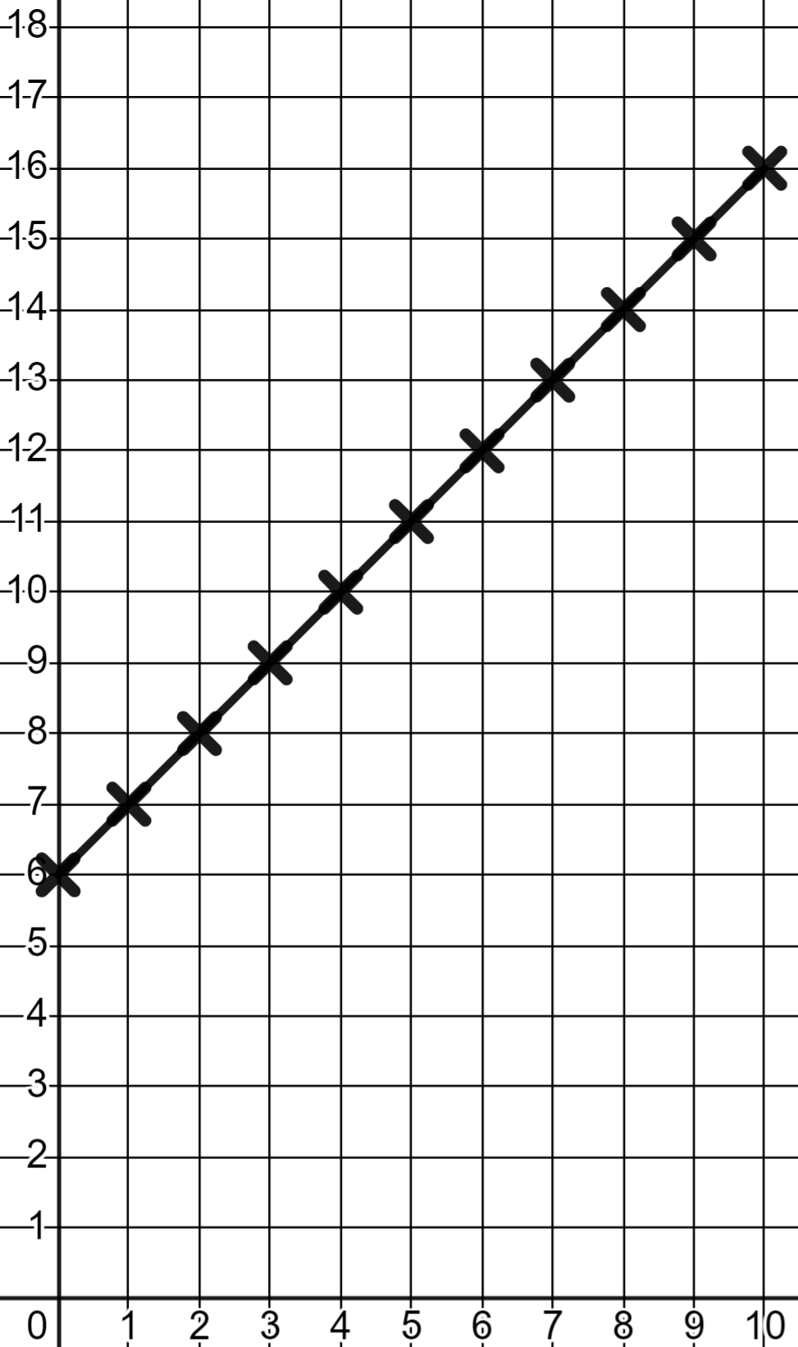
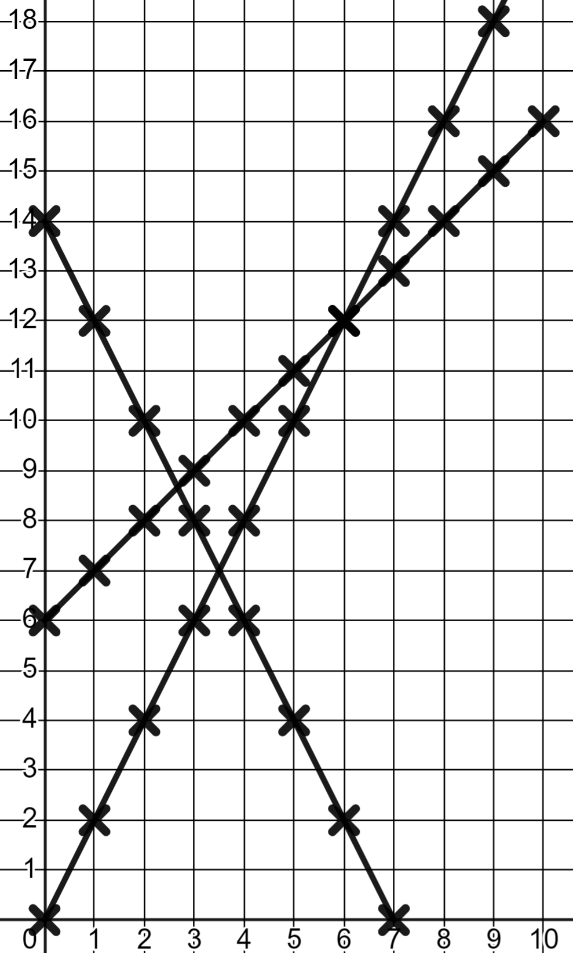
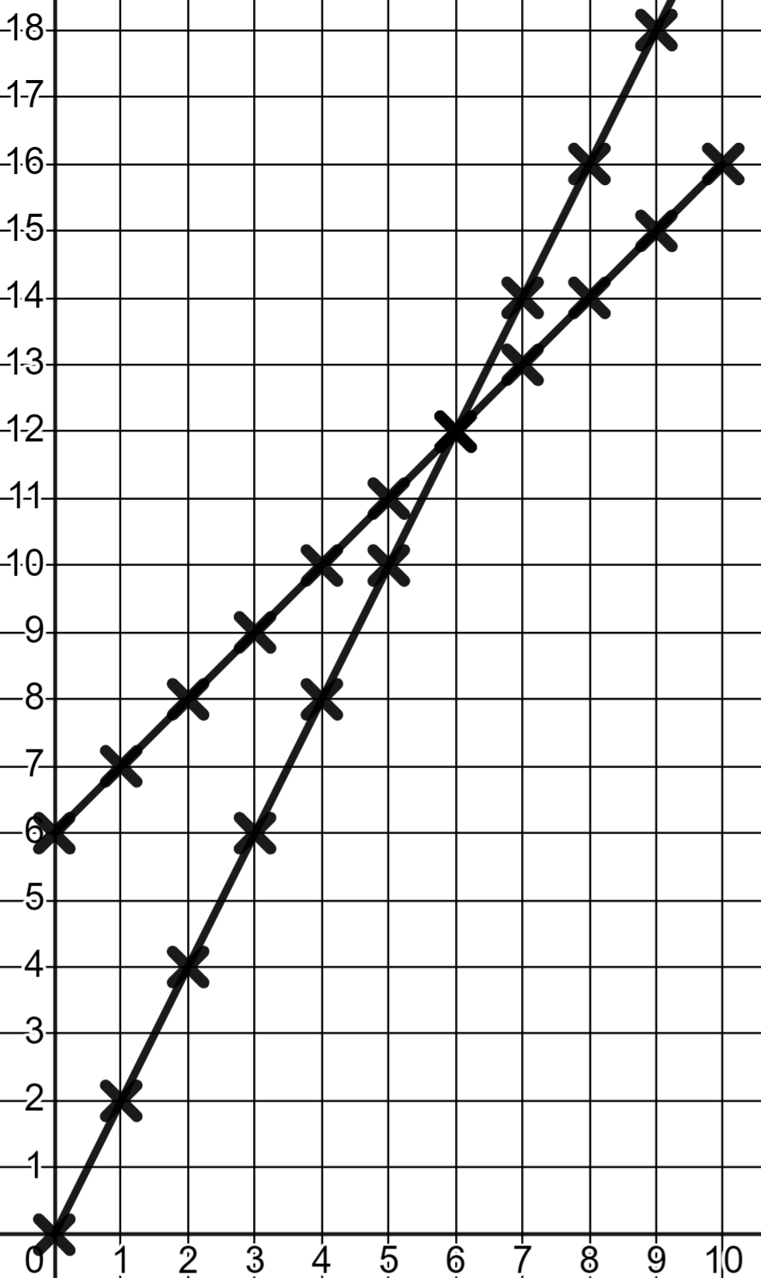
Problems involving linear graphs
s = 2d
s = 6 + d
Sweets (s)
s = 6 + d
s = 2d
s = 14 − 2d
s = 14 − 2d
What key moments can you now see?
Days (d)

Slide 12
Problems involving linear graphs
s = 2d
By day 4 Izzy already has the least.
Sweets (s)
s = 6 + d
At day 6 Aisha and Jacob are equal.
Beyond day 6 Jacob’s faster rate of change means he will always have more.
s = 14 − 2d
What key moments can you now see?
Days (d)

Slide 13
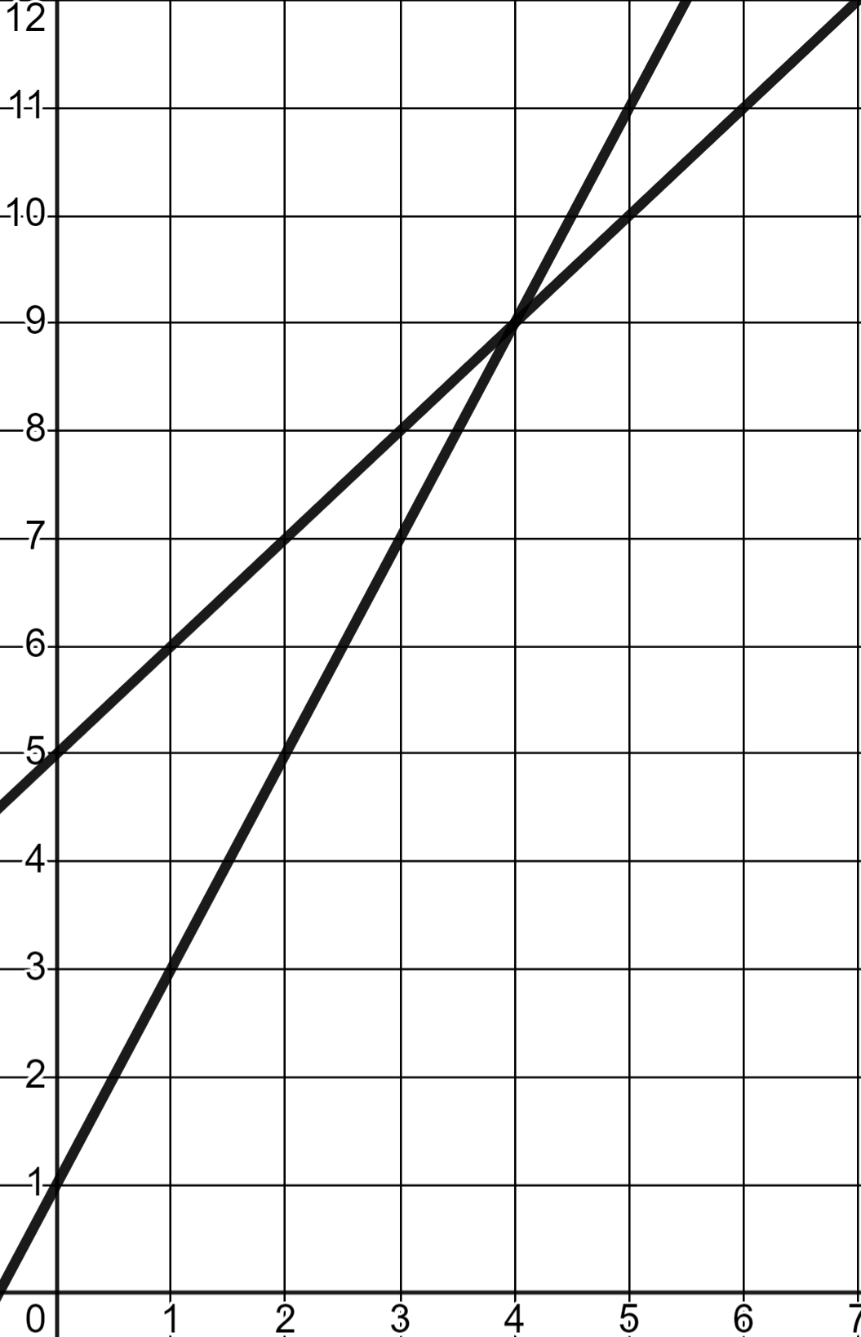

Problems involving linear graphs
In this scenario who has the most sweets after 2 days?
Sweets (s)
Aisha
Izzy
✖
Izzy
✖
Aisha
They had the same
Days (d)

Slide 14
Problems involving linear graphs
How many sweets did Izzy begin with?
Sweets (s)
5
Izzy
1
✖
Aisha
6
Days (d)

Slide 15
Problems involving linear graphs
How many sweets does Aisha gain every day?
Sweets (s)
4
Izzy
1
Aisha
2
+2
Days (d)

Slide 16
Problems involving linear graphs
In this scenario who has the most sweets after 200 days?
Sweets (s)
Aisha
Aisha’s faster rate of change means she will always have more than Izzy beyond day 4.
Izzy
Izzy
Aisha
It’s not on this graph so we can’t tell.
Days (d)

Slide 17



Problems involving linear graphs
Many real life scenarios can be modelled by linear graphing.
Some pupils are discussing saving money.
Lucas starts the year with £50 and saves £2 per week.
s = 50 + 2w
Laura starts the year with £0 but saves £5 per week.
s = 5w
Sam starts the year with £100 in savings but spends £1 per week.
s = 100 − w
Constant rates of change make linear relationships.

Slide 18
Problems involving linear graphs
Fill in the tables of values.
s = 50 + 2w
Week (w) | 1 | 2 | 3 | 4 | 5
£ savings (s) | 52 | 54 | 56 | 58 | 60
Week (w) | 1 | 2 | 3 | 4 | 5
£ savings (s)
s = 5w
Week (w) | 1 | 2 | 3 | 4 | 5
£ savings (s) | 5 | 10 | 15 | 20 | 25
Week (w) | 1 | 2 | 3 | 4 | 5
£ savings (s)
s = 100 − w
Week (w) | 1 | 2 | 3 | 4 | 5
£ savings (s)
Week (w) | 1 | 2 | 3 | 4 | 5
£ savings (s) | 99 | 98 | 97 | 96 | 95
5 weeks in and the values are nowhere near each other. Sometimes it’s useful to change the scale.

Slide 19
Problems involving linear graphs
Fill in these tables of values.
s = 50 + 2w
Week (w) | 0 | 5 | 10 | 15 | 20 | 25
£ savings (s) | 50 | 60 | 70 | 80 | 90 | 100
Week (w) | 0 | 5 | 10 | 15 | 20 | 25
£ savings (s)
s = 5w
Week (w) | 0 | 5 | 10 | 15 | 20 | 25
£ savings (s)
Week (w) | 0 | 5 | 10 | 15 | 20 | 25
£ savings (s) | 0 | 25 | 50 | 75 | 100 | 125
s = 100 − w
Week (w) | 0 | 5 | 10 | 15 | 20 | 25
£ savings (s) | 100 | 95 | 90 | 85 | 80 | 75
Week (w) | 0 | 5 | 10 | 15 | 20 | 25
£ savings (s)
Now let’s graph these relationships.

Slide 20
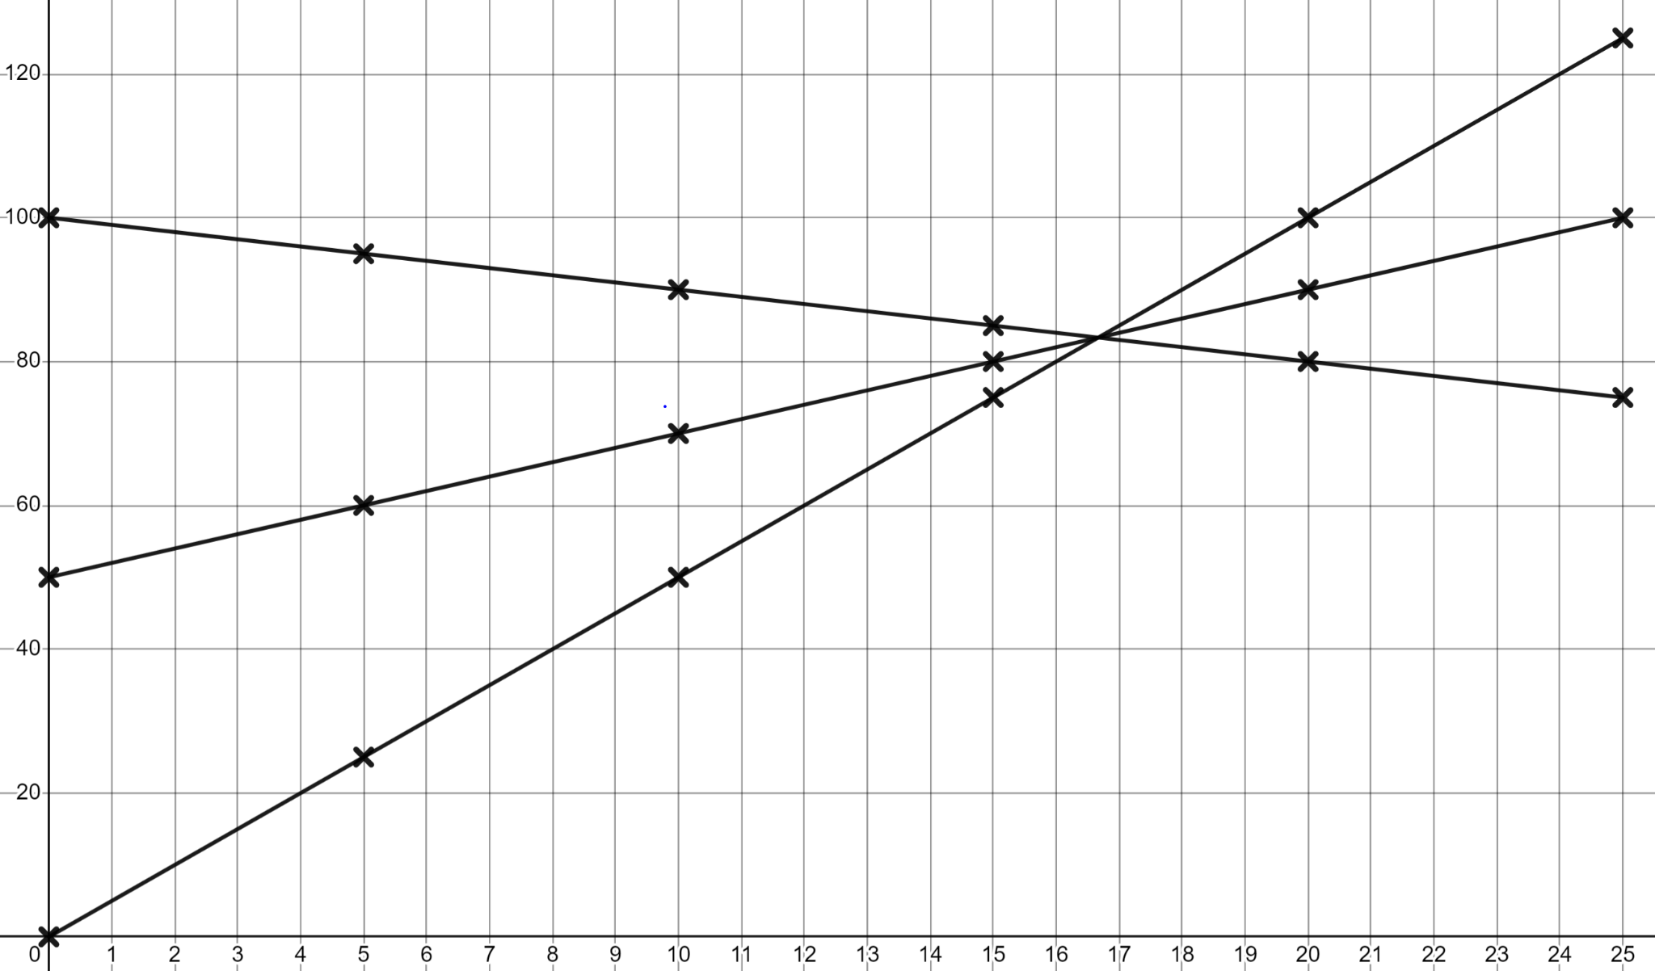
Problems involving linear graphs
A graph makes comparisons clear.
s = 50 + 2w
s = 100 − w
s = 5w
Savings (s)
s = 50 + 2w
s = 100 − w
s = 5w
Weeks (w)
During the 17th week they all have the same. Laura ends up with the most.
During the 17th week they all have the same.

Slide 21
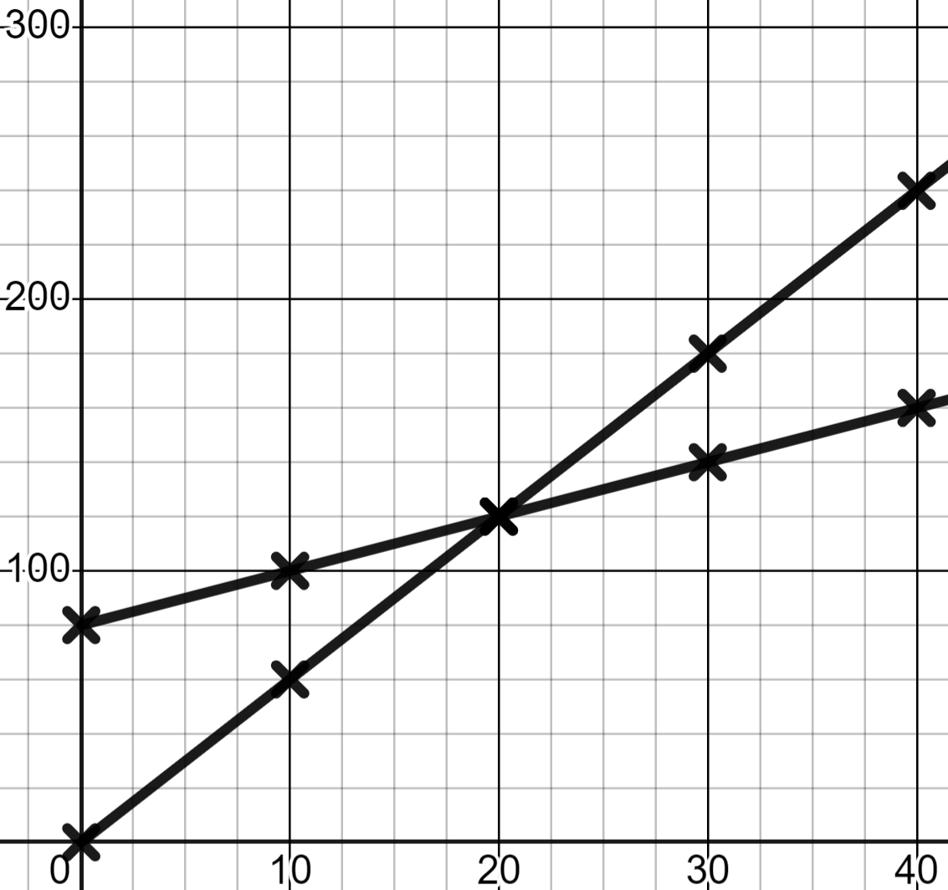

Problems involving linear graphs
For this graphical representation which statements are true?
Savings (s)
Sam has the greater savings.
Only initially.
In week 30 Lucas has £40 more.
Sam
Two steps of £20.
A scale of 10 is appropriate for the weeks axis.
1 would not have been efficient.
Lucas
Weeks (w)
In week 100 Lucas will have more.
Provided these linear relationships continue.

Slide 22
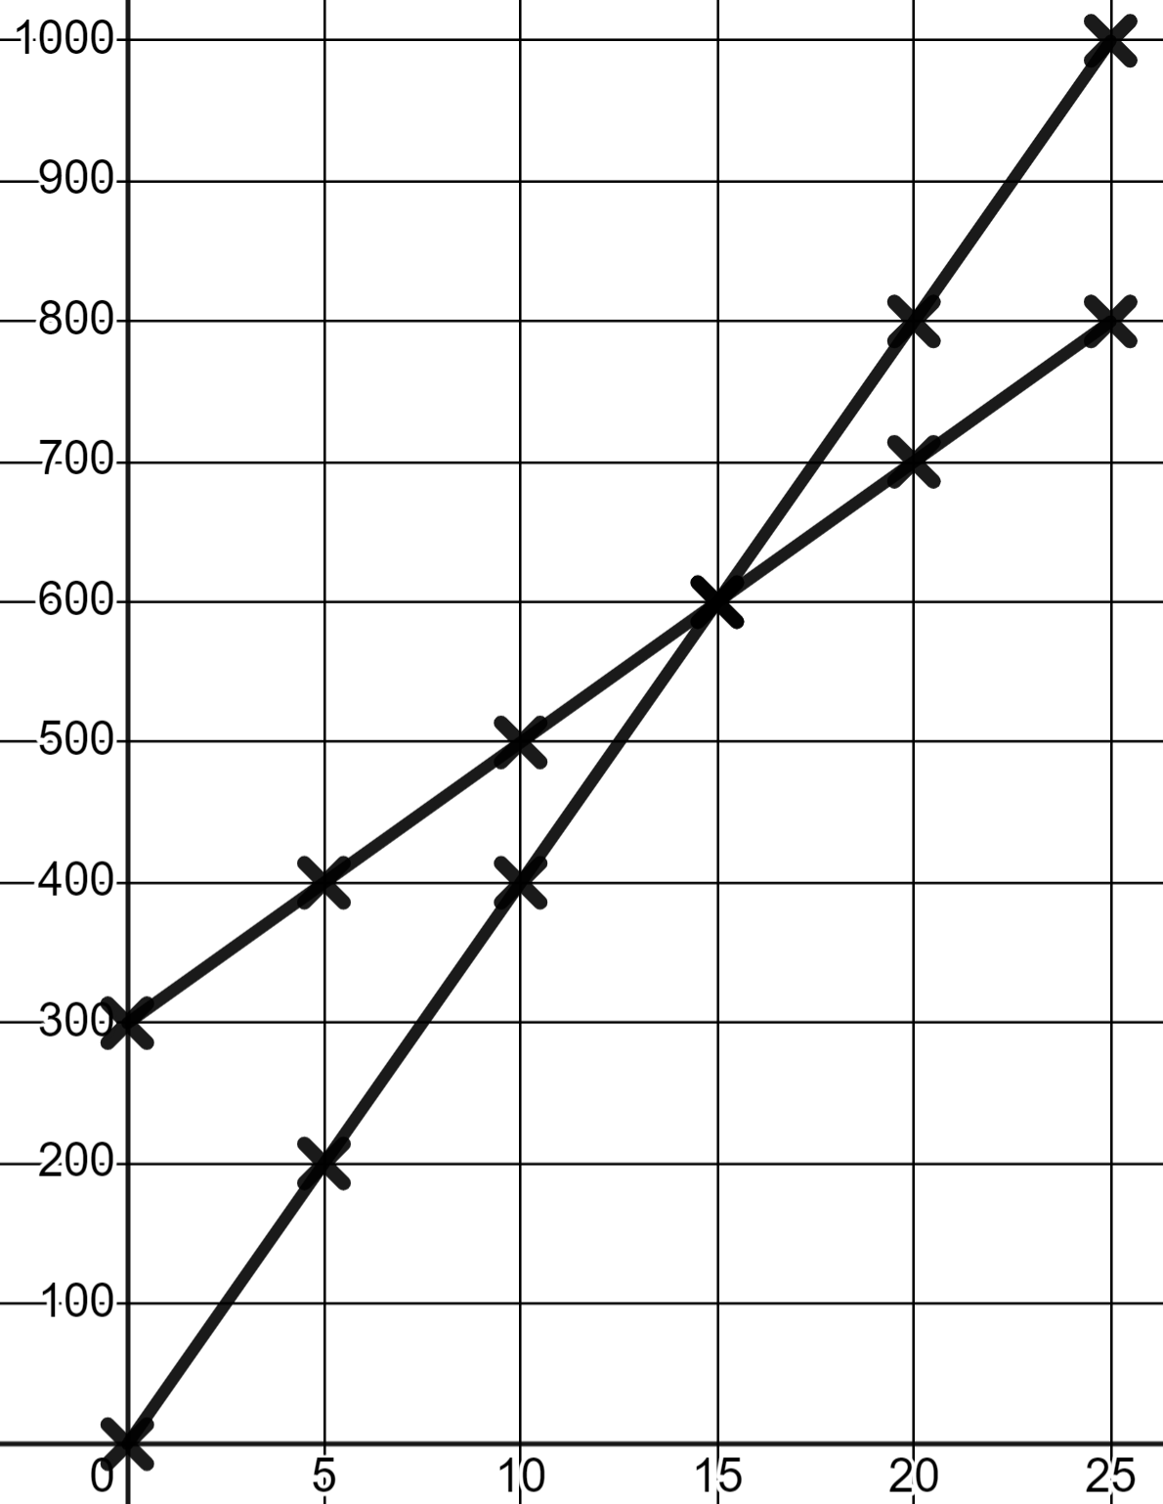
Problems involving linear relationships
1) Andeep and Jun fill a bucket each from two different taps. This is graphed here.
Volume in ml (v)
a) Who started with some water in their bucket already?
Andeep
b) Who had the smaller bucket?
c) Whose tap has the faster rate of flow?
d) When was Andeep’s bucket half full?
Jun
Seconds (s)

Slide 23
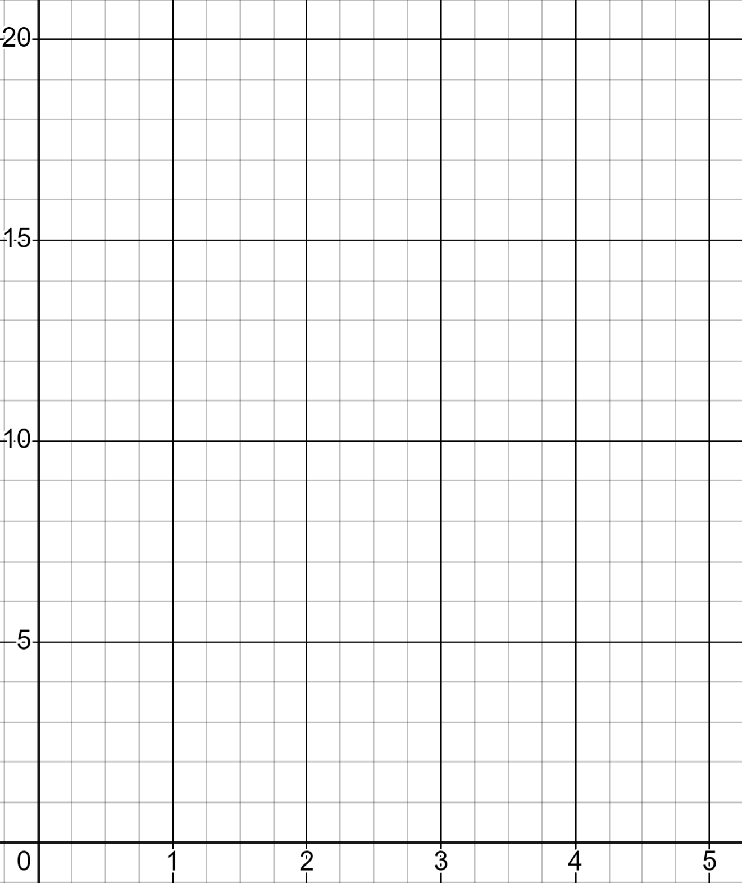
Problems involving linear relationships
2) In your town there are three taxi companies.
Company A charge a flat rate of £4 then £2 for every mile travelled.
Cost in £ (c)
Company B charge a flat rate of £8 then £1 for every mile travelled.
Company C charge no flat rate and £4 for every mile travelled.
Miles (m) | 0 | 1 | 2 | 3 | 4 | 5
Cost in £ (c)
Miles (m)
a) Fill in three tables of values and plot three lines.
b) Write a paragraph explaining the conditions in which each firm is best.

Slide 24
Problems involving linear relationships
1) Andeep and Jun fill a bucket each from two different taps. This is graphed here.
Volume in ml (v)
a) Who started with some water in their bucket already?
Andeep starts with 300 ml.
Andeep
b) Who had the smaller bucket?
Andeep. His is full at 800 ml.
c) Whose tap has the faster rate of flow?
Jun. His flows at 200 ml per 5 sec.
d) When was Andeep’s bucket half full?
Jun
Seconds (s)
After 5 seconds.

Slide 25
Problems involving linear relationships
2) In your town there are three taxi companies.
Company A charge a flat rate of £4 then £2 for every mile travelled.
Miles (m) | 0 | 1 | 2 | 3 | 4 | 5
Cost in £ (s)
Miles (m) | 0 | 1 | 2 | 3 | 4 | 5
Cost in £ (s) | 4 | 6 | 8 | 10 | 12 | 14
Company B charge a flat rate of £8 then £1 for every mile travelled.
Miles (m) | 0 | 1 | 2 | 3 | 4 | 5
Cost in £ (s)
Miles (m) | 0 | 1 | 2 | 3 | 4 | 5
Cost in £ (s) | 8 | 9 | 10 | 11 | 12 | 13
Company C charge no flat rate and £4 for every mile travelled.
Miles (m) | 0 | 1 | 2 | 3 | 4 | 5
Cost in £ (s)
Miles (m) | 0 | 1 | 2 | 3 | 4 | 5
Cost in £ (s) | 0 | 4 | 8 | 12 | 16 | 20

Slide 26
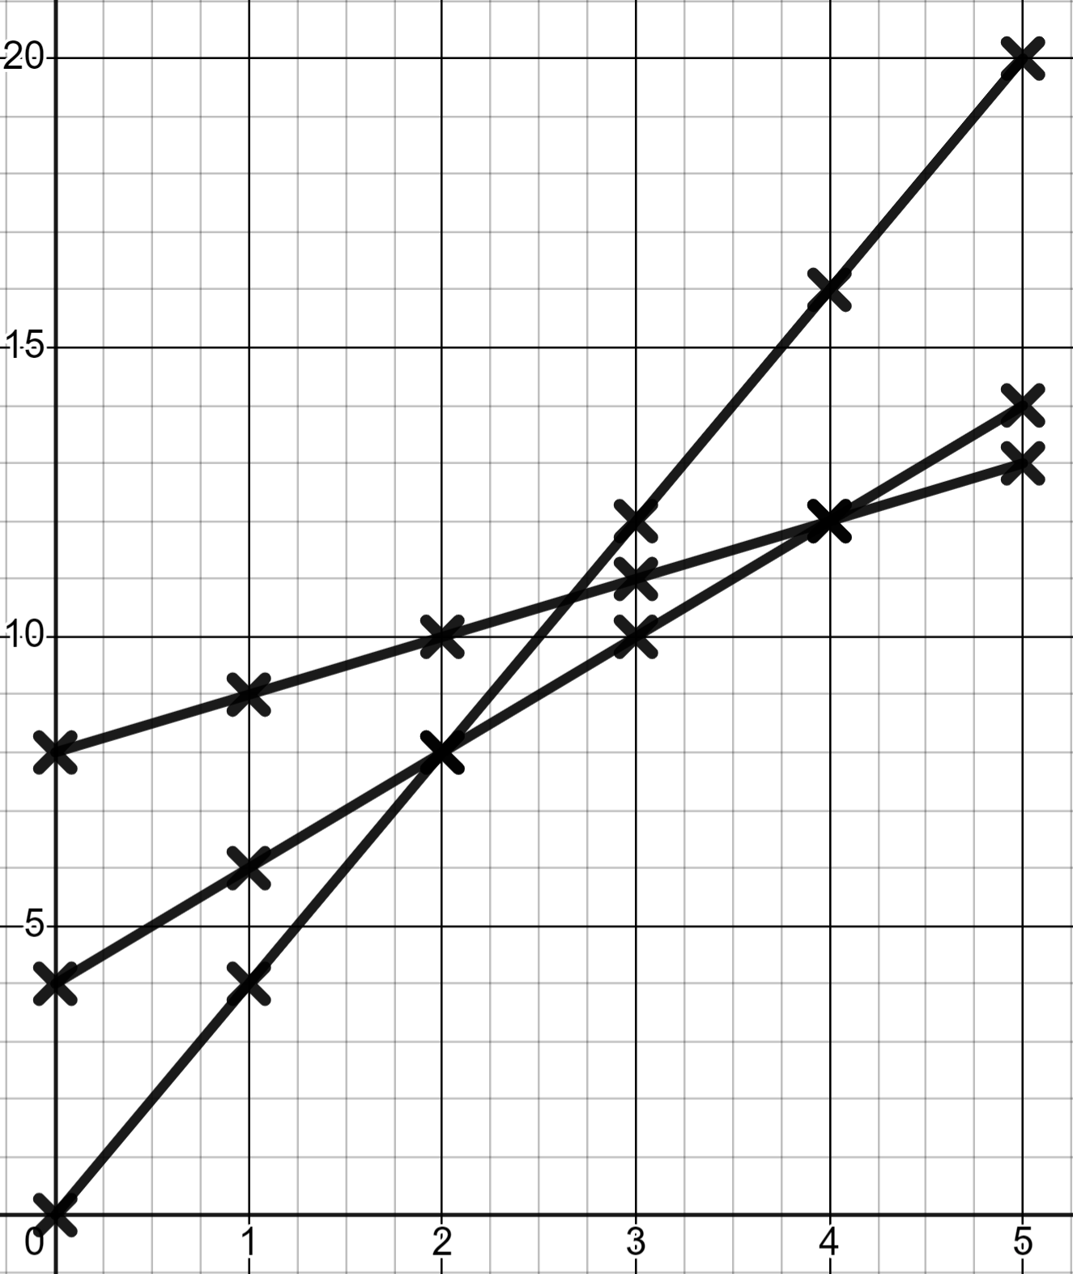
Problems involving linear relationships
2) b) Write a paragraph explaining the conditions in which each firm is best.
C
You might have written:
Initially company B are the most expensive and C the cheapest but, after 2 miles C become more expensive than A who are now cheapest.
You might have written:
Initially company B are the most expensive and C the cheapest but, after 2 miles C become more expensive than A who are now cheapest. At 4 miles A becomes more expensive than B who are now the cheapest, and will remain cheaper for any further journeys because their rate per mile is lowest.
You might have written:
Initially company B are the most expensive and C the cheapest
Cost in £ (c)
A
B
Miles (m)

Slide 27
Problem solving with graphing linear relationships
Problems involving linear graphs
Interpreting more complex linear graphs

Slide 28


Interpreting more complex linear graphs
Aisha runs the 100 metres at sports day. Below is a table of values of her performance.
+3
+3
+3
+3
+3
Time (t) | 0 | 3 | 6 | 9 | 12 | 15
Distance (d) | 0 | 8 | 20 | 40 | 70 | 100
+8
+12
+20
+30
+30
Why will this not make a linear graph?
There is not a constant rate of change.

Slide 29
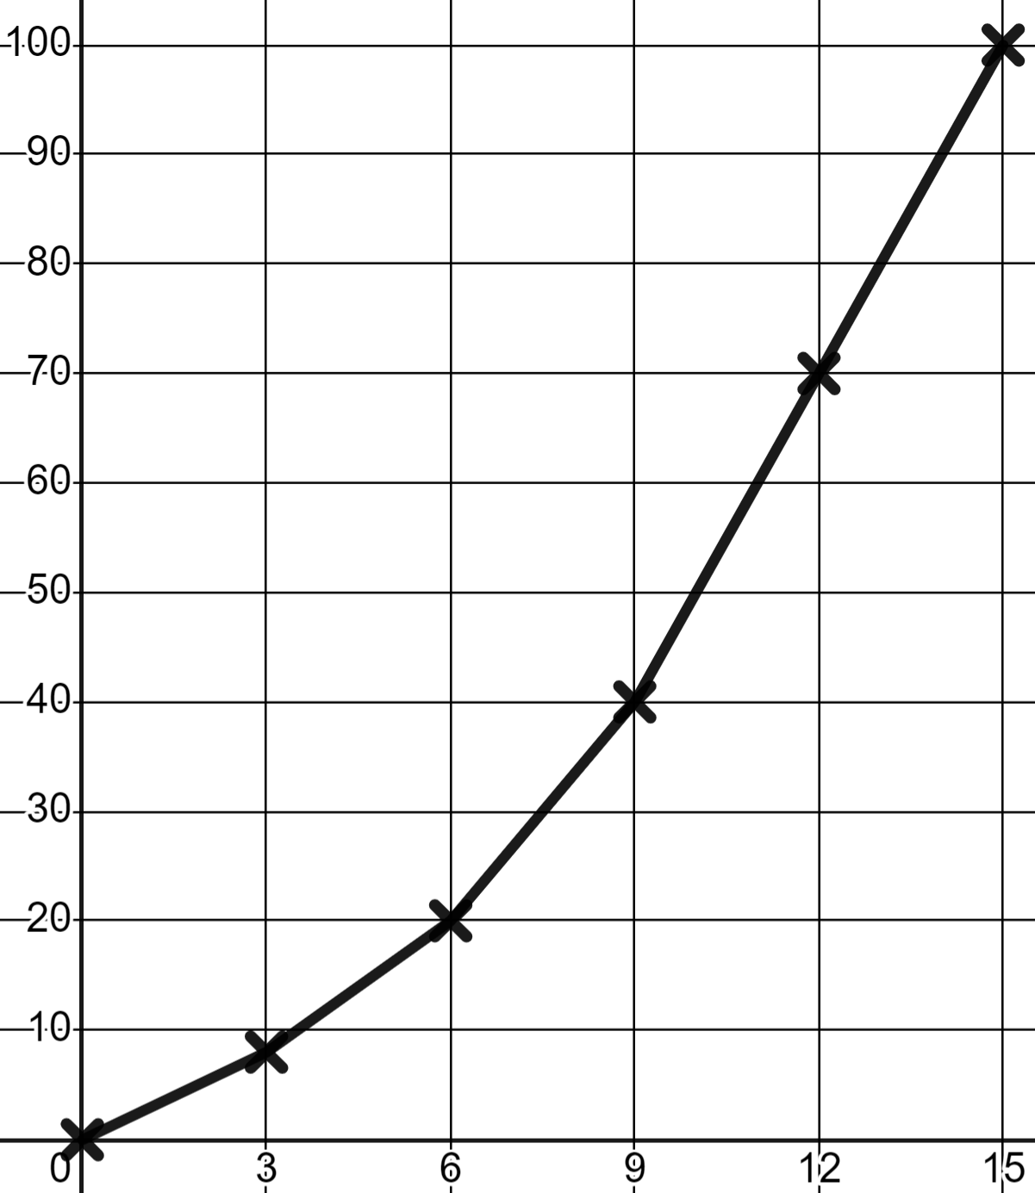
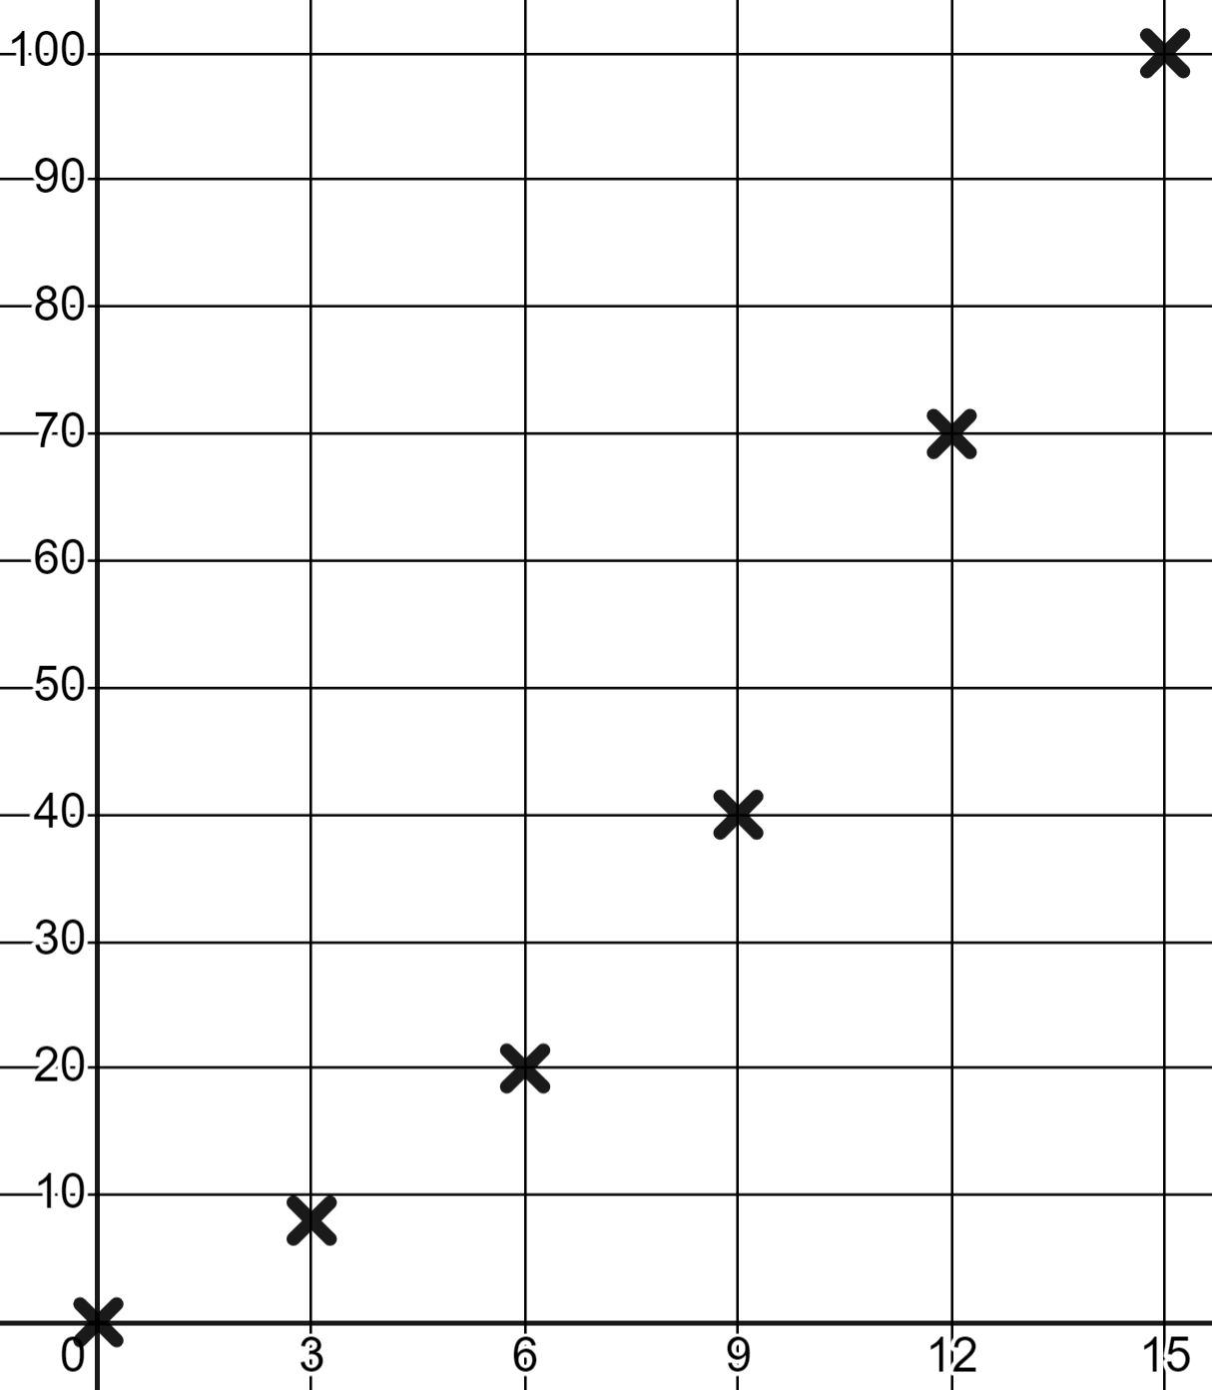
Interpreting more complex linear graphs
Whilst not linear, the graph does have useful features.
d
Time (t) | 0 | 3 | 6 | 9 | 12 | 15
Distance (d) | 0 | 8 | 20 | 40 | 70 | 100
The line is getting steeper; the gradient increased.
Aisha was running faster at the end. A greater distance in the same time period.
t

Slide 30
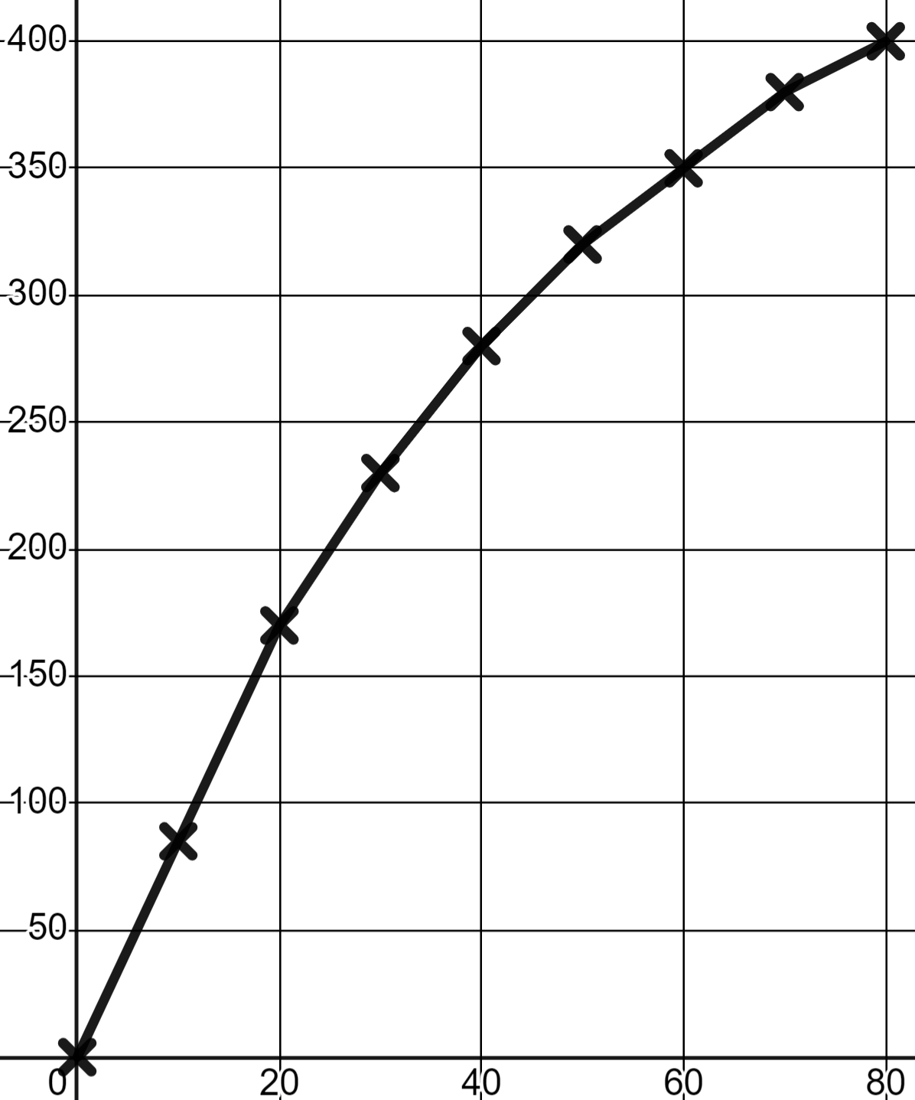
Interpreting more complex linear graphs
Aisha speeds up at the end of this 400 metre race.
d
A change in gradient means she has sped up.
A decrease in gradient means she has slowed down.
t

Slide 31
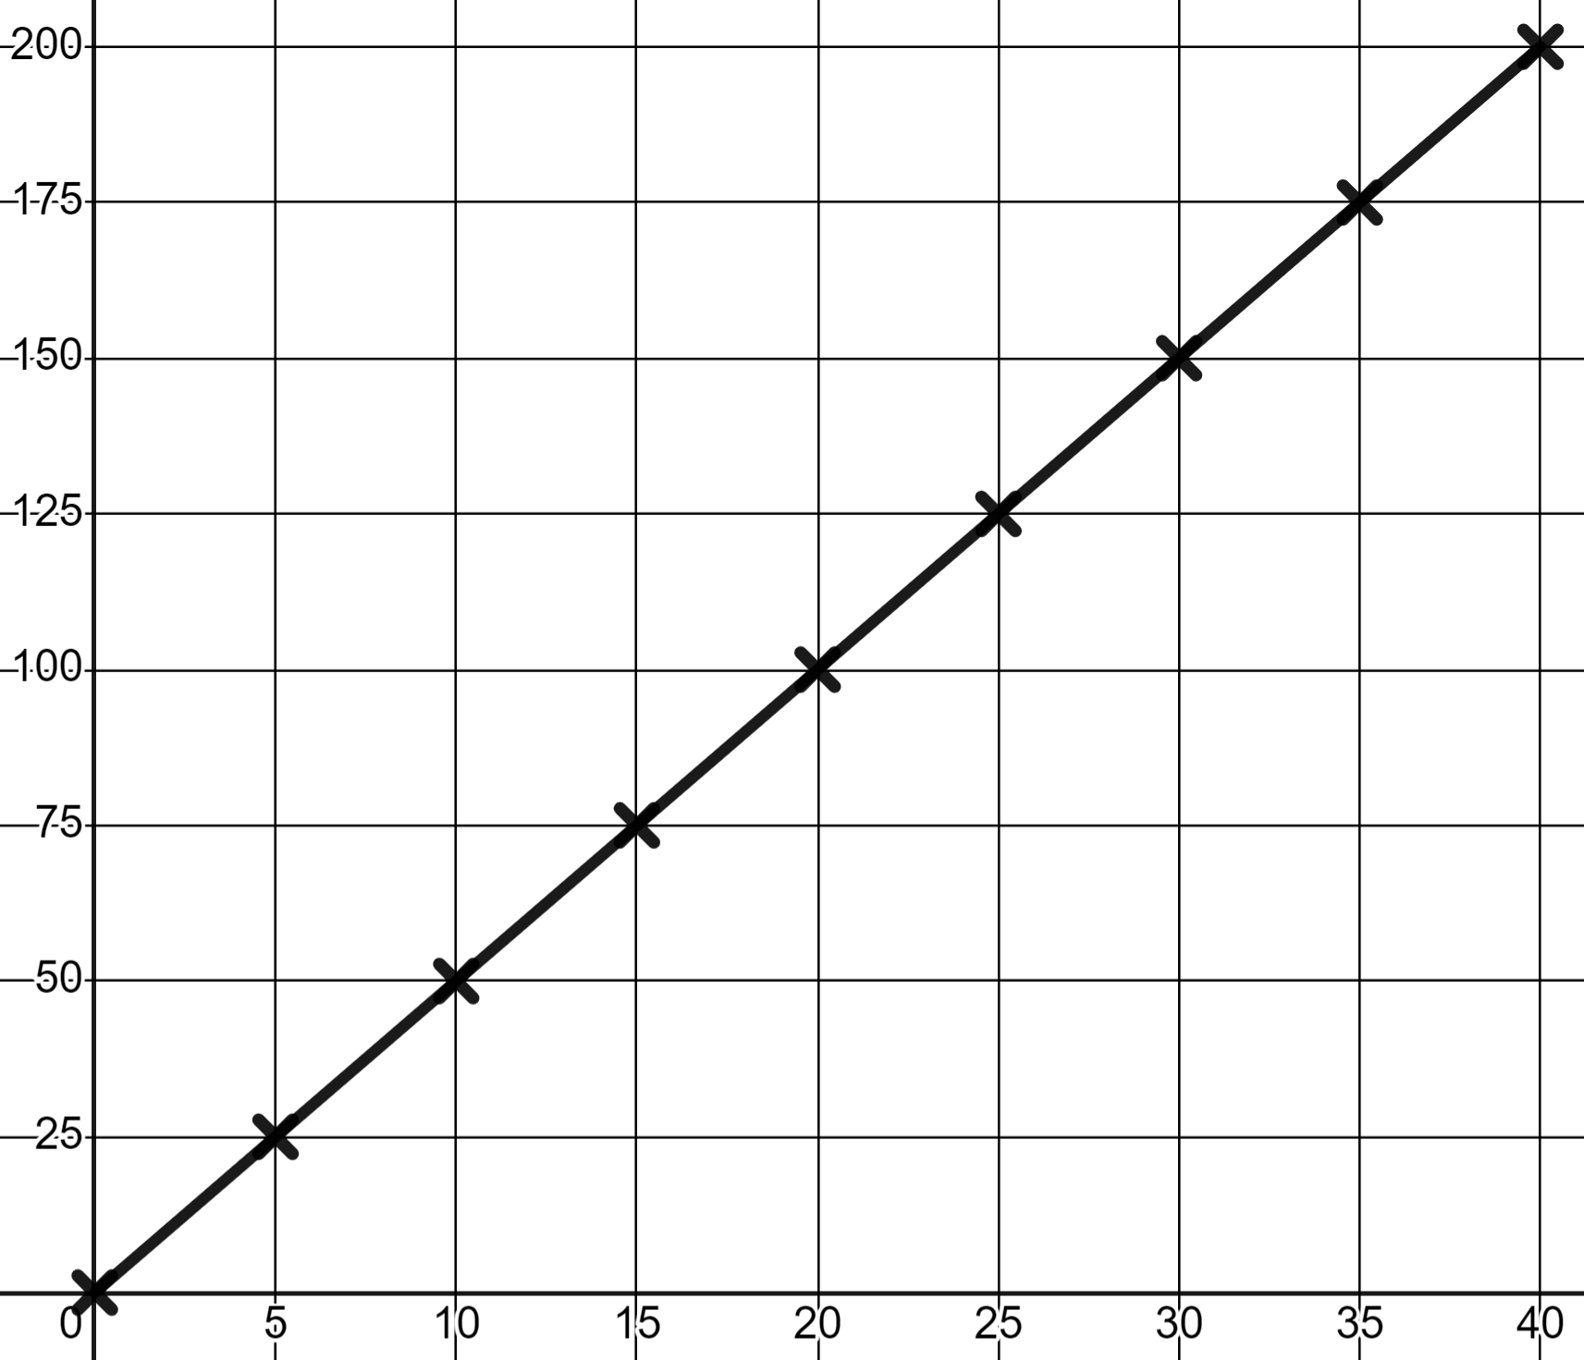

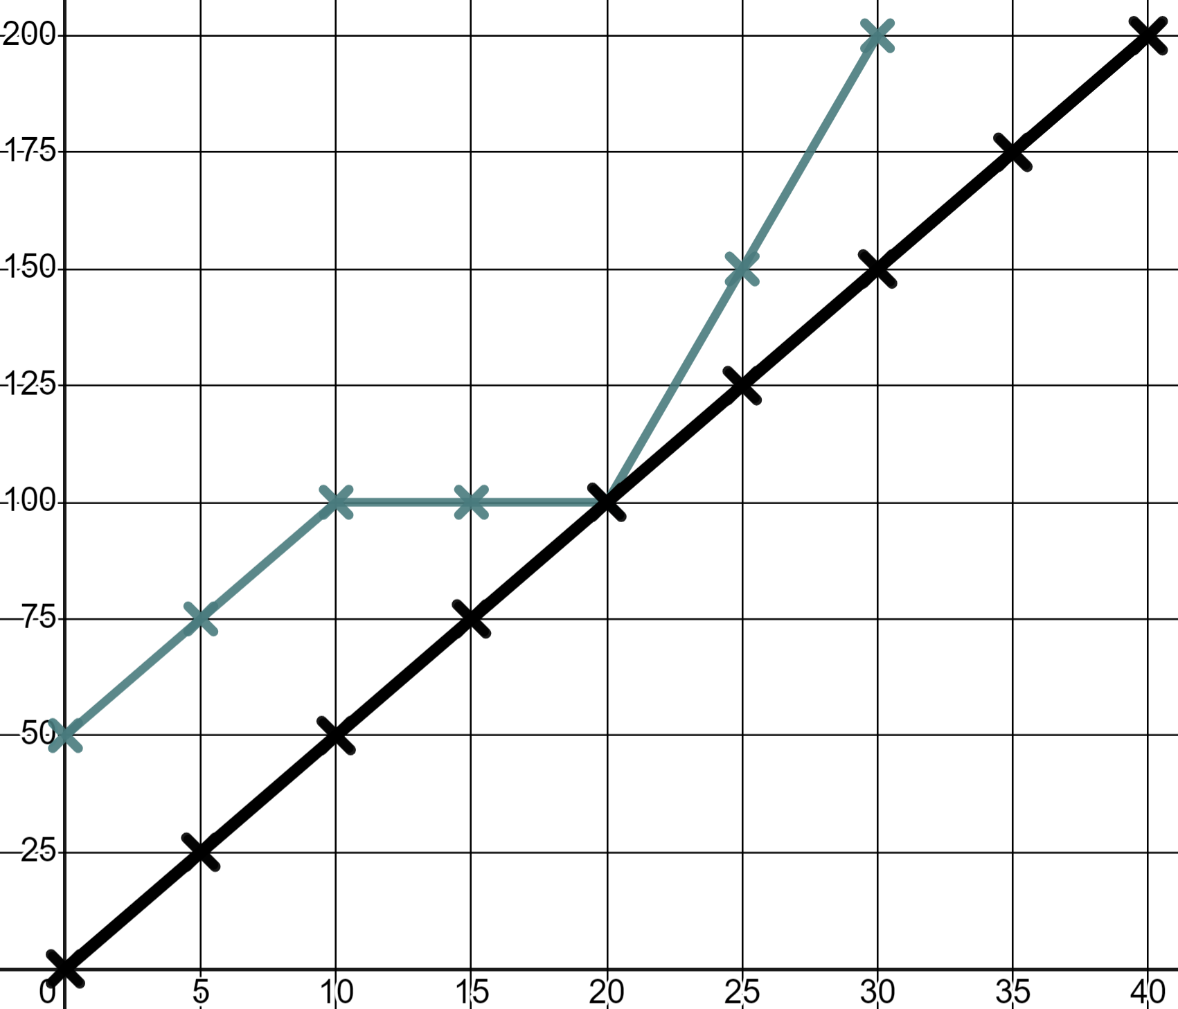

Interpreting more complex linear graphs
Sam runs the 200 metres.
d
What do you notice?
A straight line, a constant rate of change, a constant speed.
Alex also ran. What do you notice about their race?
A 50 m head start.
A stop between 10 and 20 seconds.
A fast finish and victory!
t

Slide 32
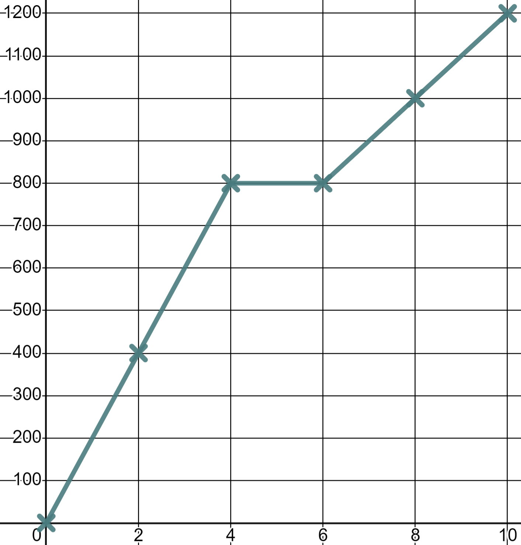

Interpreting more complex linear graphs
Izzy cycles to school.
What happens after 4 minutes?
d
She speeds up.
She slows down.
She stops.
t
0 distance covered from 4 to 6 minutes shows a stop.

Slide 33
Interpreting more complex linear graphs
Izzy cycles to school.
When is she going fastest?
d
between 0 and 4 minutes
The fastest rate of change, the steepest gradient, is this moment.
between 0 and 800 minutes
between 6 and 10 minutes
t

Slide 34
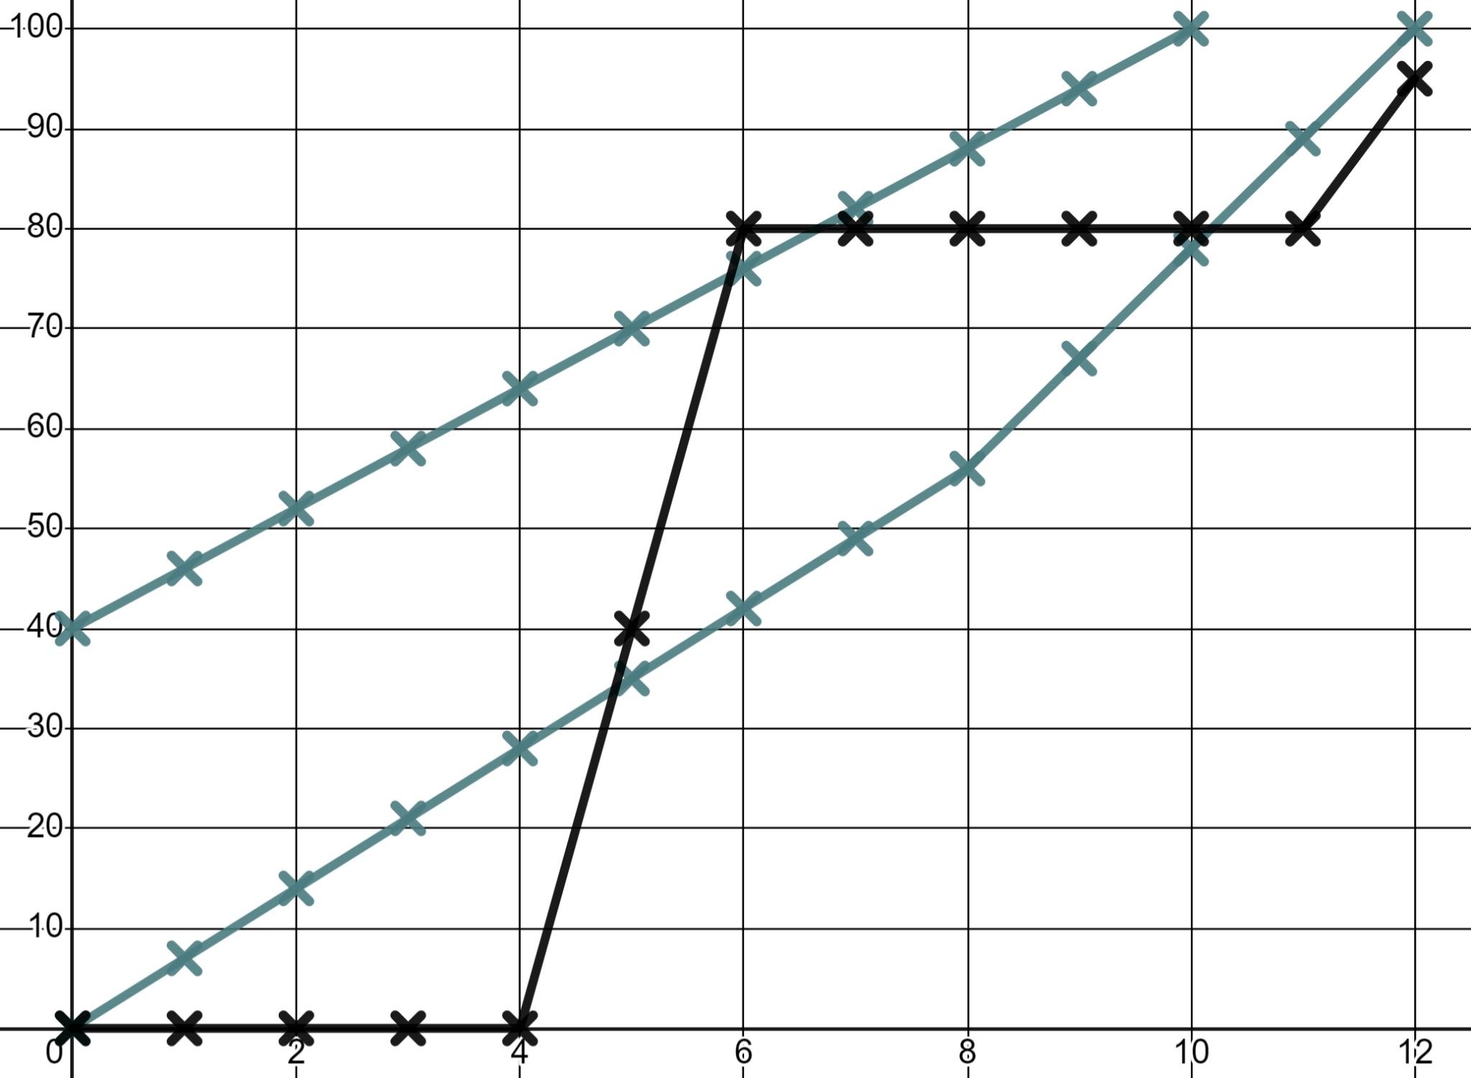
Interpreting more complex linear graphs
1) Write a commentary to describe this race.
d
The distance units are metres. The time is in seconds.
Keep your commentary in chronological (time) order.
Sofia
Andeep
Laura
t

Slide 35
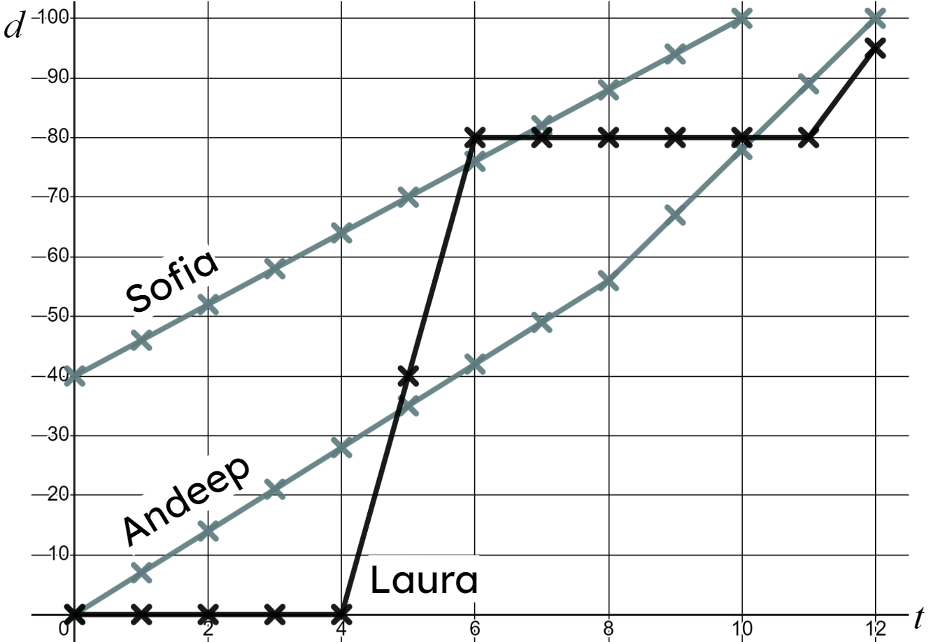
Interpreting more complex linear graphs
1) You might have written:
And they’re off! Andeep and Sofia start at a constant speed, Sofia with her 40 metre headstart. 2 seconds in and Sofia has passed the 50 metre mark but Laura hasn’t even started yet; what is she doing!
Finally, after 4 seconds Laura starts and wow, does she start! That is the fastest speed we’ve seen yet in this race! Within a second of her starting she overtakes Andeep, within 2 seconds she is passed Sofia. But then she stops! She must think the race is over!

Slide 36
Interpreting more complex linear graphs
1) continued…
8 seconds in, Sofia is still moving at the same, constant speed. She’s overtaken Laura who looks like she might be asleep but, Andeep speeds up slightly to try and catch Sofia; will it be enough!
It’s not! After 10 seconds Sofia hits the finish line for the gold medal. Andeep joins her 2 seconds later in silver position. Laura finally woke up and started running again but didn’t even even get to the finish line.

Slide 37
Problem solving with graphing linear relationships
We can use our knowledge of linear relationships to solve real life problems and interpret what is happening in graphical models of real life situations.
For example, the impact of gradient in a time distance graph.

Slide 38

© Oak National Academy 2023.
Produced in partnership with Mathematics in Education and Industry.
Licensed on the Open Government Licence v3.0, except where otherwise stated. See Oak terms and conditions.

